Slide 1
Bone anatomy and physiology
Dr. Mahdi H. Hammadi
PhD Sc. Clinical Physiology

Slide 2
Bone Anatom
Bones are made of active, living cells that are busy growing, repairing themselves, and communicating with other parts of the body.

Slide 3
How many bones are in the human body?
The skeleton of an adult human is made up of 206 bones of many different shapes and sizes. Added together, your bones make up about 15% of your body weight. Newborn babies are actually born with many more bones than this (around 300), but many bones grow together, or fuse, as babies become older. Some bones are long and thick, like your thigh bones. Others are thin, flat, and wide, like your

Slide 4
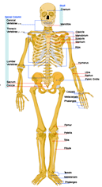

Slide 5
Function:
Support
Protection
Movement
Blood Cell Formation
Storage

Slide 6
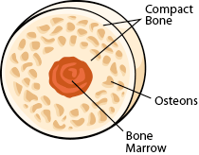

Slide 7
What are your bones made of?
Each bone in your body is made up of three main types of bone material:
Compact bone
Spongy bone
Bone marrow.

Slide 8
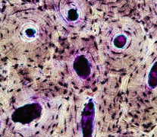

Slide 9
Compact bone :
Compact bone is the heaviest, hardest type of bone.
It needs to be very strong as it supports your body and muscles as you walk, run, and move throughout the day.
About 80% of the bone in your body is compact.
It makes up the outer layer of the bone and also helps protect the more fragile layers inside.
If you looked at it through a microscope:
Filled with many very tiny passages, or canals, for nerves and blood vessels.
Compact bone is made of special cells called osteocytes. These cells are lined up in rings around the canals.
Together, a canal and the osteocytes that surround it are called osteons.
Osteons are like thick tubes all going the same direction inside the bone

Slide 10
Spongy bone:
Is found mostly at the ends of bones and joints.
About 20% of the bone in your body is spongy.
Unlike compact bone that is mostly solid, spongy bone is full of open sections called pores.

Slide 11
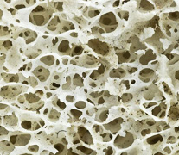

Slide 12
Bone marrow
The inside of your bones are filled with a soft tissue called marrow. There are two types of bone marrow:
Red marrow
Yellow marrow
Red bone marrow:
Is where all new red blood cells, white blood cells, and platelets are made.
Red bone marrow is found in the center of flat bones such as your shoulder blades and ribs.

Slide 13
Yellow marrow:
is made mostly of fat
And is found in the hollow centers of long bones, such as the thigh bones.
It does not make blood cells or platelets.
Both yellow and red bone marrow have many small and large blood vessels and veins running through them to let nutrients and waste in and out of the bone.

Slide 14
Bones are made of four main kinds of cells:
Osteoclasts
Osteoblasts
Osteocytes
lining cells

